Slide 1
*
$ 202 bn
* Global Management Consultants - Market Research Report (2014-2029) - IBIS World

Slide 2
The amount of money annually lost in the consulting industry from utilization gap.

Slide 3
More than the GDP of 138 Countries

Slide 4

April 2025
Nexvion

Slide 5
1
10 DAYS
average allocation time. Slow project-staffing cycle affect costs and can tip proposals to faster competitors.
2
71% (ONLY)
Problem
1
Chronic under-utilisation remains a
common problem in the services industry
For a 100 Consultant Firm, that is
~5mil Euros lost every year.
EXISTING STAFFING PROCESS FOR A NEW PROJECT IS A MESS
3
51%
of consultancies still coordinate staffing mainly with spreadsheets, another 28 % juggle disconnected point tools;
1.https://insights.consultancygrowthnetwork.com/hubfs/BenchPress%202023/Consultancy%20BenchPress%202023%20-%20Abridged%20report.pdf
2. https://sipp-content-uk.dystrick.com/wp-content/uploads/2023/10/2023-professional-services-maturity-benchmark.pdf
3. https://insights.consultancygrowthnetwork.com/hubfs/BenchPress%202023/Consultancy%20BenchPress%202023%20-%20Abridged%20report.pdf

Slide 6

Solution
An AI Staffing System that reduces the week long process into a few clicks
FASTER
TURNAROUND
BETTER
MATCHES
SCALABILITY
If we can shorten the staffing cycle from days to minutes, firms can start projects sooner and bill more hours.
AI can consider a wider range of factors and comb through hundreds of profiles instantly, surfacing matches a human might miss.
As firms grow or handle more simultaneous projects, manual staffing becomes a bottleneck. We can help tackle that problem.

Slide 7

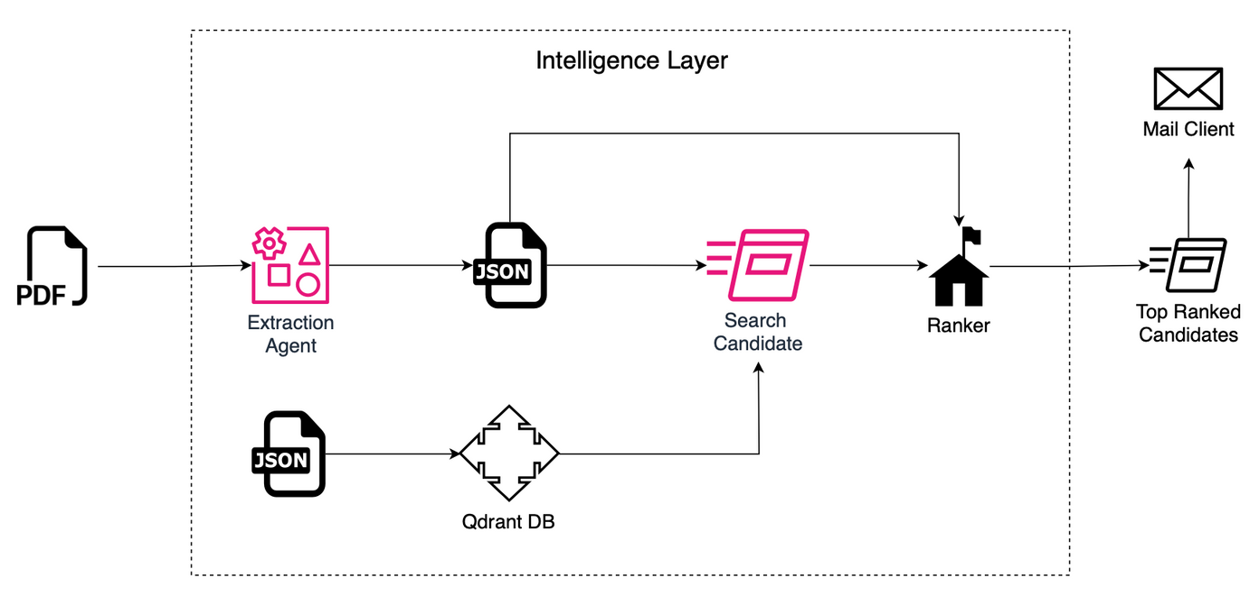





A look under the hood
Simple and smart.

Slide 8
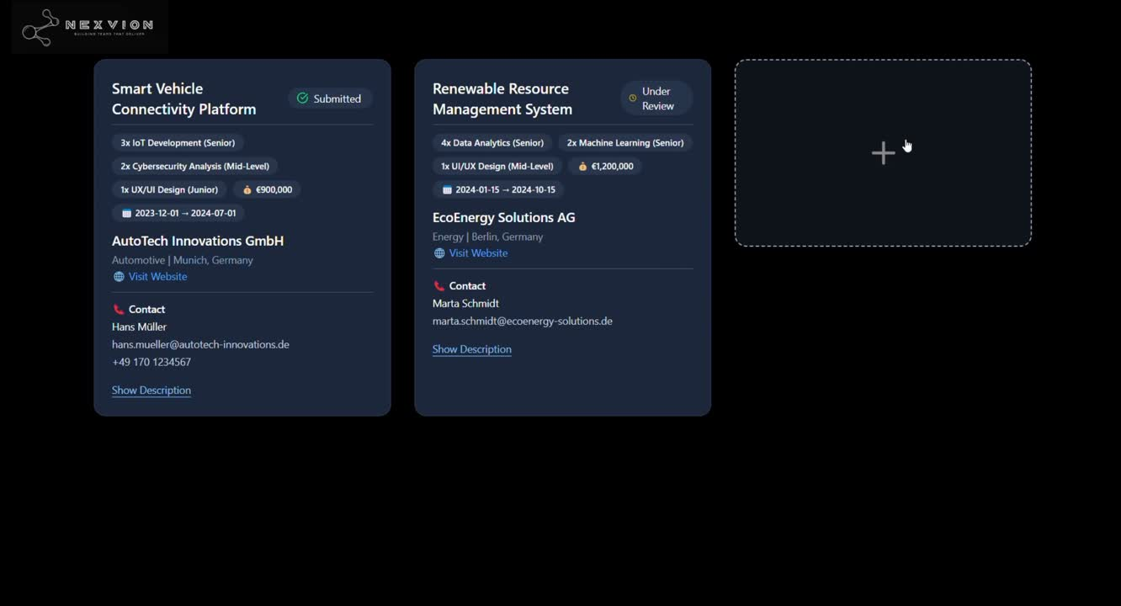
Demo
Do you want to see a magic trick?

Slide 9
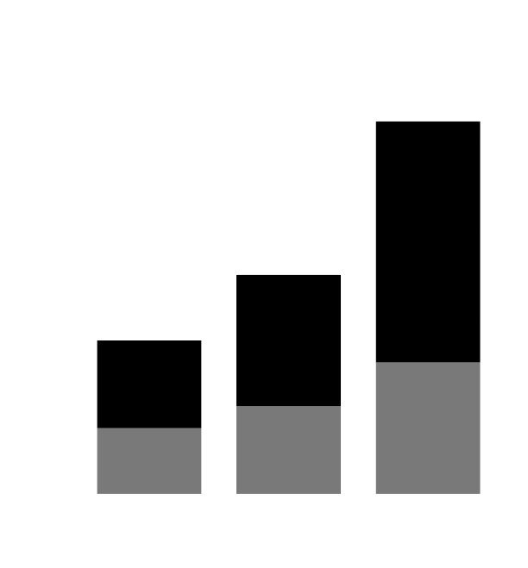

Market and Opportunity
Staffing Automation - A growing nieche in one of the world's biggest markets.
GLOBAL SERVICES MARKET
TAM VS SAM VS SOM IN STAFF AUTIMATING SYSTEMS
9T $
Initial SOM: 100 firms
€2 M ARR in 3 yrs
300m €
6.3T $
6.1T $
150m €
€46.7 B German consulting market;
4000+ tech consultancies
300m €
The market is expected to continue
growing (e.g. ~5–6% CAGR)
10m €
2024
2025
2029

Slide 10




You choose your plan
Diverse SaaS subscription model for a diverse market
Tier | Monthly platform fee | Included AI project-calls¹ | Ideal customer size
Free / Pilot | € 0 | 5 / month | Small squads, proof-of-concepts
Pro | € 10 / project-call(billed as € 499 for 50 calls;) | 50 included | 10-150 consultants
Pro-100 | € 899 | 100 included | 151-300 consultants
Enterprise | Custom | 1000+ (pooled) | >300 consultants / multi-office
Free
Pro
Pro-100
Enterprise

Slide 11
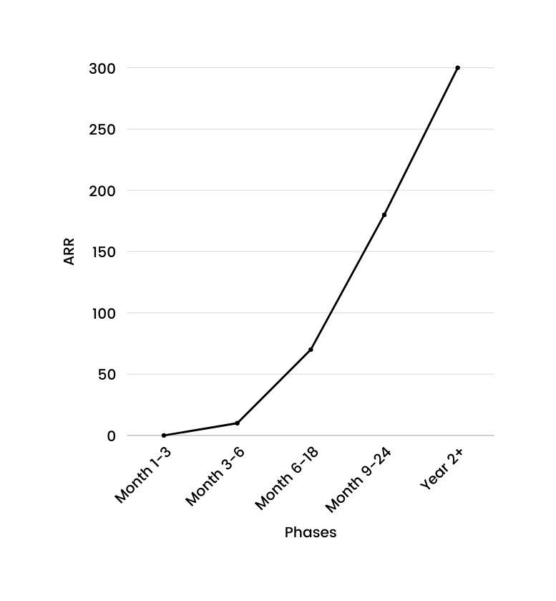
GTM
Goal to 200 Paying Customers in 2 Years
Phase | Objective | Timing | Expected ARR
1. Awareness & Lead Gen | Fill top-of-funnel in DACH tech consultancies | Mo 1-3 | Pipeline only
2. Land & Pilot | Convert early adopters → paid logos | Mo 3-6 | ≈ €0.1 M
3. Expand & Scale | Upsell & secure first enterprise deals | Mo 6-18 | ≈ €0.7 M
4. Channel & Partners | Multiply reach cost-efficiently | Mo 9-24 | ≈ €1.8 M
5. Thought-Leader Positioning | Own AI-staffing category globally | Year 2+ | €3 M+ run-rate

Slide 12

MULTI-FORMAT INPUT SUPPORT
1
CLIENT COMMUNICATION AUTOMATION
2
Future Stages
of Research
FEEDBACK INTEGRATION & OPTIMIZATION
3
Future features
FULL PROJECT LIFECYCLE AUTOMATION
4
INTRODUCE ENCRYPTION, USER ROLES,
AND ACCESS CONTROLS.
5

Slide 13
Our Team
A diverse team set of expertise, working for a common goal.
FRONT END DEV
TAUFIQ EAMBOLI
AI DEV
CHINTAN VEKARIYA
BUSINESS AND DESIGN
VINAYAK JOSHI
RPTU Kaiserslautern
Uni Mannheim
TU Darmstadt
BACK END DEV
JAHANVI PANCHAL
BACK END DEV
AVANI GANDHI
Uni Mannheim
Uni Mannheim

